Slide 1
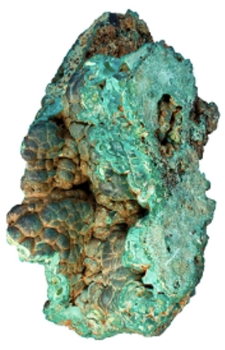
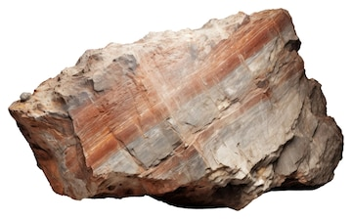
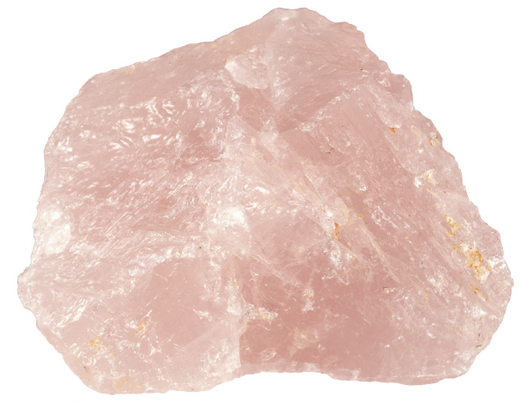
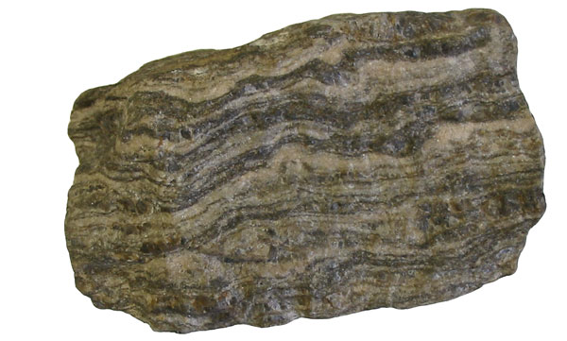


Rocks and Minerals!
Presented by UW Rockin' Out!

Slide 2
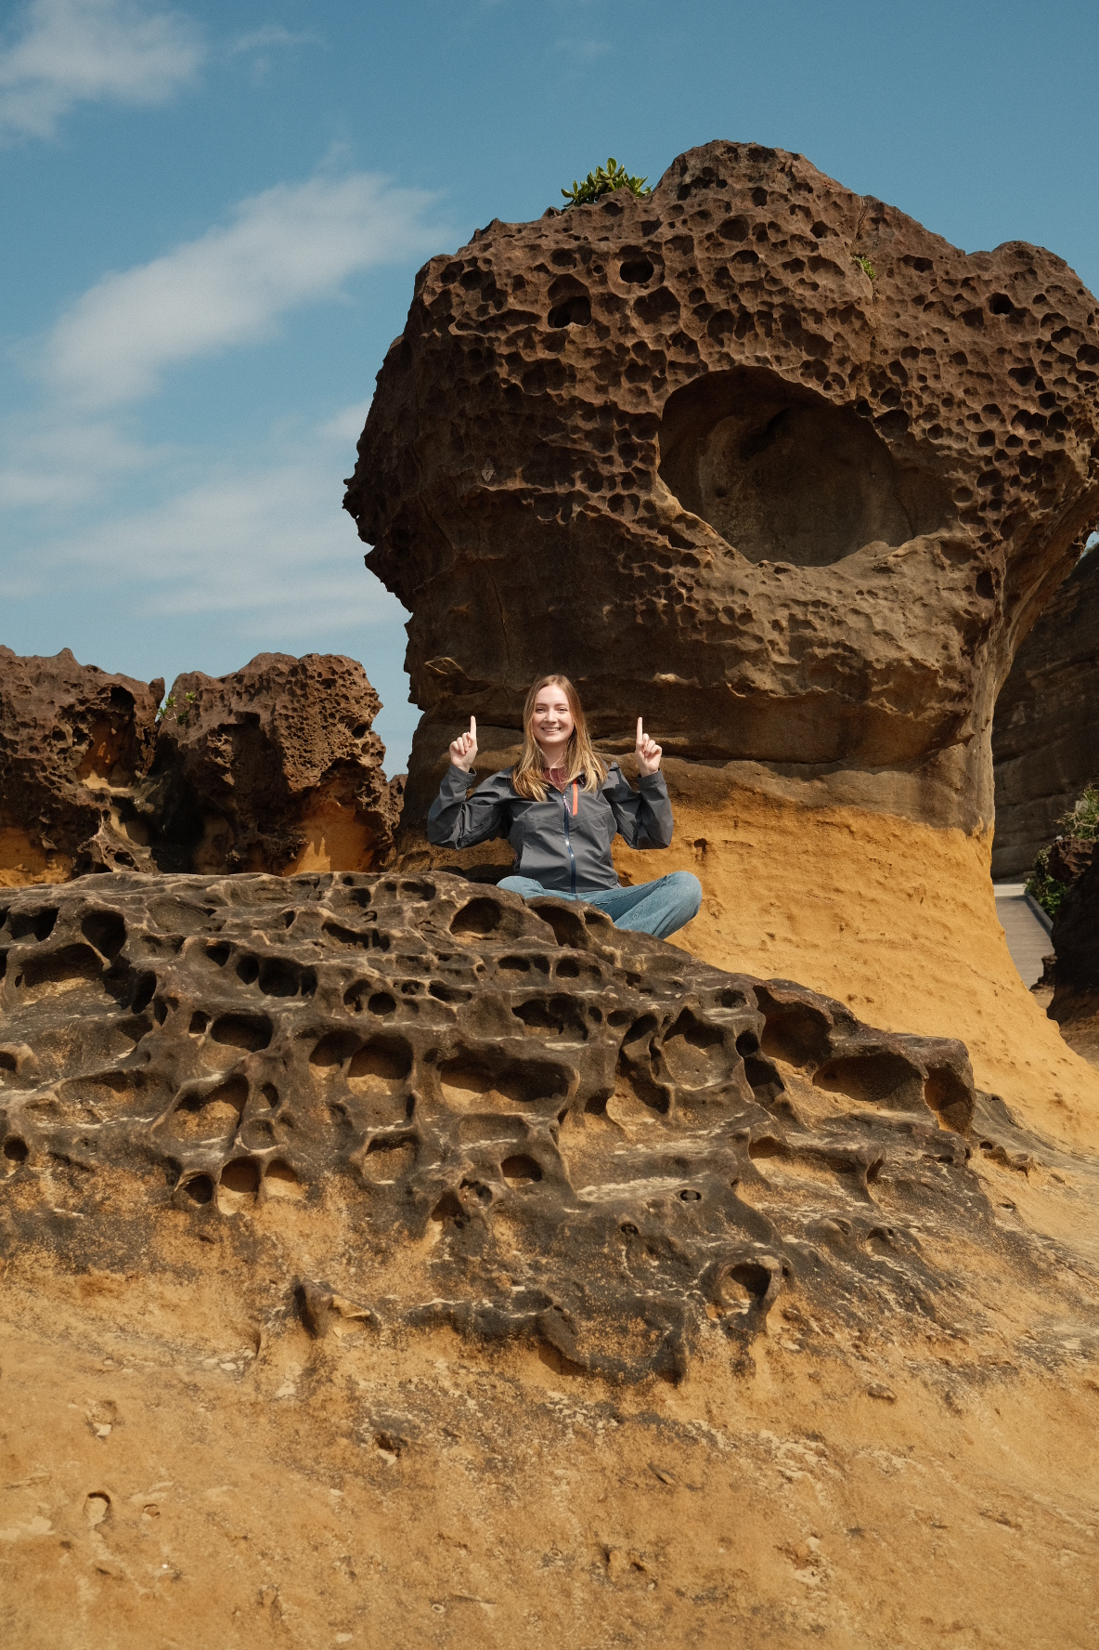
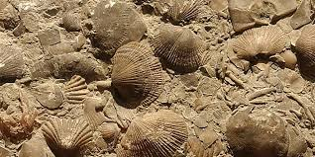
Sophia Robillard
Earth Science student at the University of Washington!
My favorite rock is fossiliferous limestone.
Yehliu Geopark, Taiwan

Slide 3

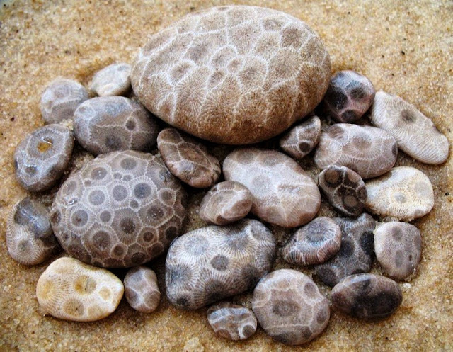
Reid Alexander
Student at the University of Washington!
My favorite rock is a Petoskey stone!
Capitol Reef National Park, UT

Slide 4
Name
Earth Science student at the University of Washington!
My favorite rock is ___ .
Caption

Slide 5
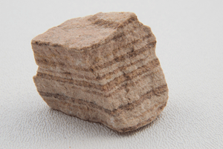
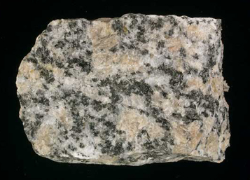
How do we classify rocks?
3 types of rocks:
Sedimentary
Igneous
Metamorphic
Sandstone
Gneiss
Granite

Slide 6
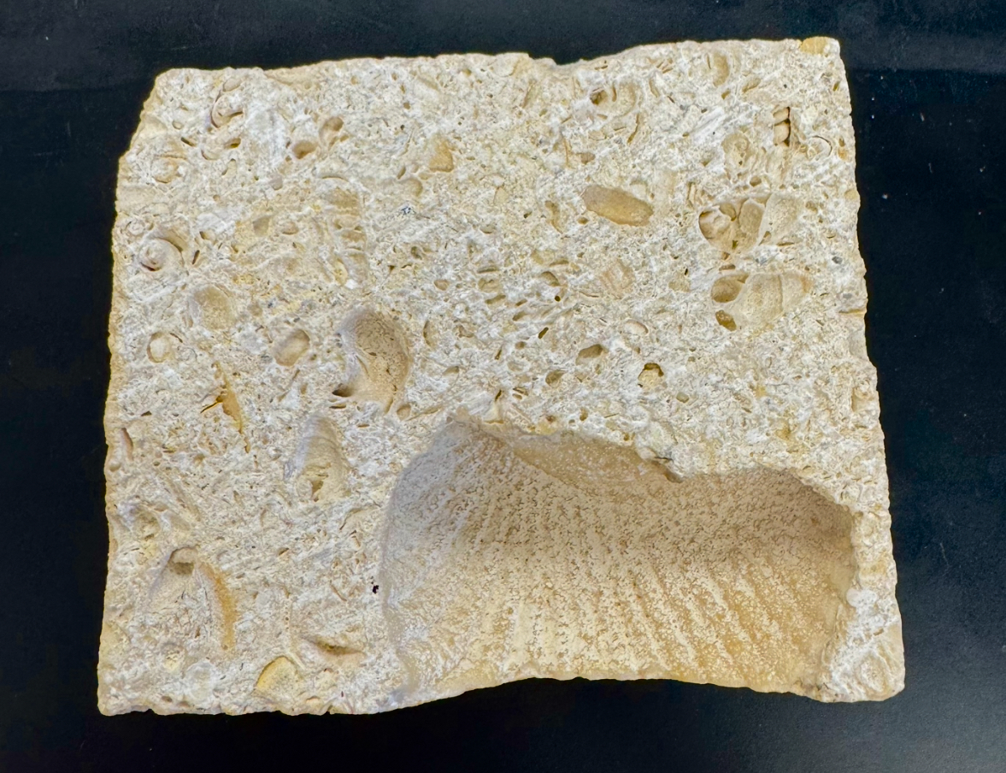
Sedimentary Rocks
Limestone
Sedimentary rocks are the most common type of rocks on Earth's surface!
May contain fossils like shells
Can form in layers
Deposited at the Earth's surface by wind, water, ice, or biology
Sandstone

Slide 7
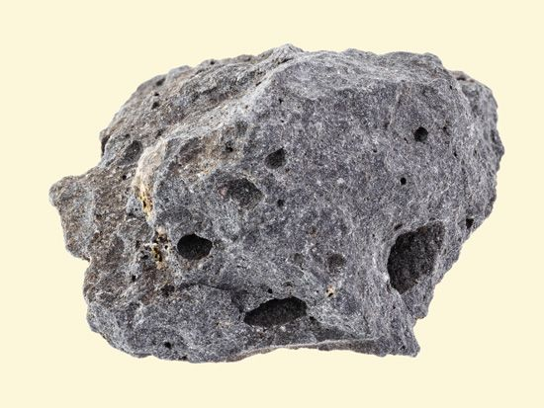
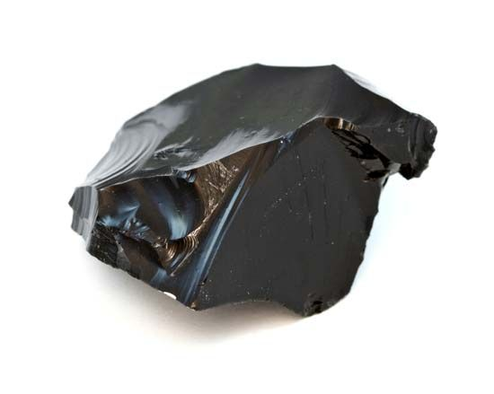
Igneous Rocks
Basalt
Form when molten rock like magma or lava cools and solidifies!
Large or small crystals
Holes where air pockets used to be
No layering
Hard rocks
Obsidian

Slide 8
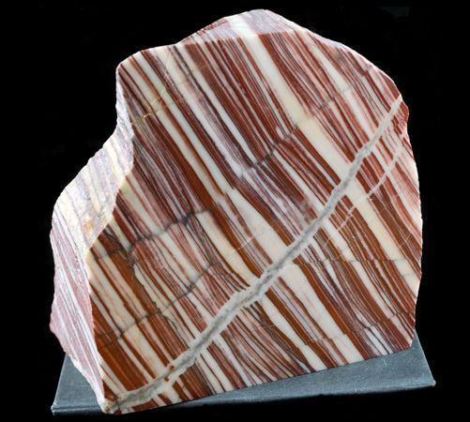
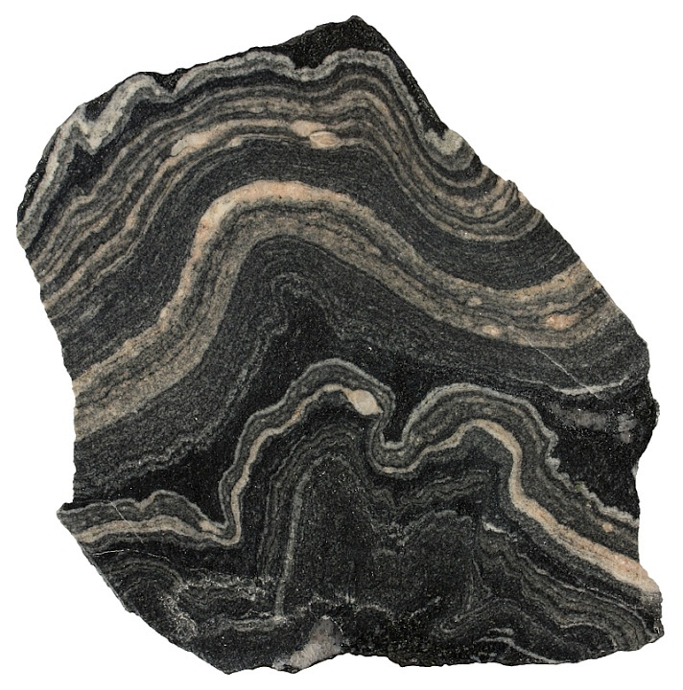
Metamorphic Rocks
Gneiss
Formed by the transformation of existing rocks by heat and pressure!
May have wavy or straight layers!
Contain Metamorphic minerals such as garnet (red) and mica (flat and shiny)

Slide 9
How do we describe rocks?

Slide 10
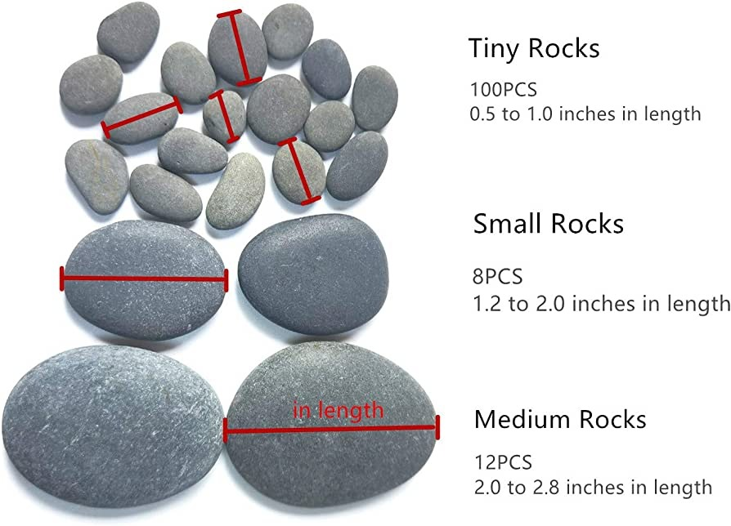
How do we describe rocks?
Size
Shape
Texture
Angularity (sharp/round edges)
Color
Weight
Hardness

Slide 11


Slide 12
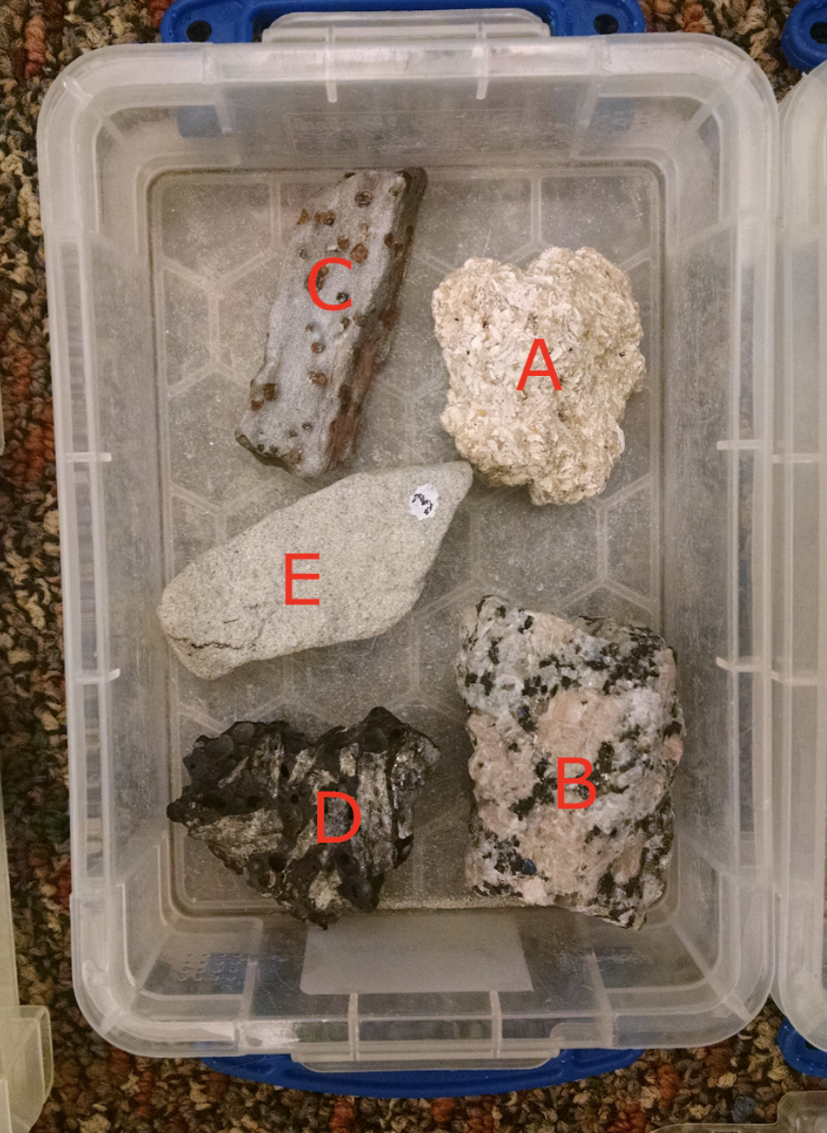
Activity for today!
Look at the rocks in your box!
What colors do you see?
Are your rocks shiny or sparkly?
How hard are your rocks?
Heavy or light?
Round or angular?
How would you classify your rock? (Sedimentary, Igneous, Metamorphic)

Slide 13
Sedimentary Rocks
Metamorphic Rocks
Igneous Rocks
Gneiss
Limestone
Basalt
Obsidian
Sandstone

